Slide 1
CAPSTONE PROJECT
HOTEL BOOKING ANALYSIS
AKHILA.V

Slide 2
Points to Discuss
Objective
Significance
Data Dictionary
ER Diagram
Steps to Connect to Data sources
Problem Statement with Solutions and Insights
Layout of the Dashboard
Conclusion

Slide 3
Objective
The objective of this project is to analyse booking patterns, guest preferences, and factors influencing cancellations in the hotel industry. Using SQL and Excel, we will identify trends in booking sources, revenue, and other key metrics. Additionally, we aim to develop a Power BI dashboard for tracking booking trends and optimizing hotel operations.

Slide 4
Significance
Understanding and optimizing booking patterns, guest preferences, and cancellation factors are crucial for the hotel industry. This analysis can help hotel managers and staff make informed decisions to improve guest satisfaction, revenue, and operational efficiency. Key areas of significance include:
Revenue Optimization: Knowing which types of rooms, meal plans, and special requests bring in the most money can lead to targeted marketing and pricing strategies.
Cancellation Management: Analyzing factors that influence cancellations, such as lead time and deposit type, can assist in reducing revenue losses and increasing room utilization.
Improved Guest Experience: Knowing your guests' preferences for meals, parking, and room types can lead to a better overall experience, potentially leading to positive reviews and repeat business.
Operational Efficiency: Monitoring booking trends and sources can help with staffing and resource allocation. It can also help with effective waiting list management.

Slide 5
Agenda
To discuss the analysis of given hotel bookings data set from 2015-2017.
We’ll be doing analysis of given data set in following ways :
Trend Analysis
Descriptive Analysis
Comparative Analysis
Segmentation Analysis
Time Series Analysis
Distribution Analysis
These insights provide a comprehensive view of the booking analysis project and can guide decision-making to enhance guest experiences and hotel operations.

Slide 6
Dataset Description
This dataset contains information on hotel bookings, guest details, meal preferences, booking source, room details, and reservation status.
Table Explanations
Room_Details
The Room_Details table provides information related to room reservations and changes made to them. It is associated with the Booking_Details table via the booking identifier. This table includes details about the type of room initially reserved, the type of room eventually assigned, and the number of changes made to the booking. It offers insights into room allocation dynamics and booking modifications.
Reservation_Status*
The Reservation_Status table records the status of reservations over time. It is connected to the Booking_Details table through the booking identifier. This table captures the reservation's last status (e.g., Canceled, Check-Out) and the date on which this status was recorded. It is valuable for tracking the progression of reservations and understanding their final outcomes.
Booking_Details
The Booking_Details table contains essential details related to hotel reservations. It includes a unique booking identifier and information about the type of hotel (Resort Hotel or City Hotel). Additionally, it records the booking's cancellation status (0 for not canceled, 1 for canceled), lead time (number of days between booking and arrival), year, month, week number, and day of the month of arrival. The table also captures the number of weekend and weekday nights stayed.

Slide 7
Guest_Info
The Guest_Info table provides insights into the guests associated with each booking. It is linked to the Booking_Details table via the booking identifier. This table records the number of adults, children, and babies accompanying the booking, offering an understanding of the composition of guests for each reservation.
Meal_And_Stay_Details
The Meal_And_Stay_Details table complements the booking information by specifying meal-related and stay-related attributes. It connects to the Booking_Details table via the booking identifier. This table includes the type of meal booked (e.g., Bed & Breakfast, Half Board), the Average Daily Rate (ADR) for the stay, the number of required car parking spaces, and the total count of special requests made by the guest.
Booking_Source_and_History
The Booking_Source_and_History table is crucial for understanding the source of bookings and the historical behavior of guests. It is connected to the Booking_Details table via the booking identifier. This table encompasses information such as the market segment (e.g., Online Travel Agents, Direct Booking), distribution channel (e.g., Online Travel Agents, Direct Booking), and whether the guest is a repeated visitor (0 for not repeated, 1 for repeated). Additionally, it records the number of previous booking cancellations, previous bookings that were not canceled, the deposit type (e.g., No Deposit, Non-Refund), the booking agent's ID, the company's ID, the number of days a booking spent on the waiting list, and the customer type (e.g., Transient, Group).

Slide 8
Data Dictionary
To effectively analyse and gain insights from the available data, we have several key tables, each with its own set of attributes:
Booking_Details
- Booking Identifier: A unique identifier for each hotel reservation.
- Hotel Type: Indicates whether the hotel is a Resort Hotel or City Hotel.
- Cancellation Status: 0 for not cancelled, 1 for cancelled.
- Lead Time: The number of days between booking and arrival.
- Year, Month, Week Number, Day of Month: Arrival date details.
- Number of Weekend Nights: Number of nights the guest will stay over the weekend.
- Number of Weekday Nights: Number of nights the guest will stay on weekdays

Slide 9
Guest_Info
- Booking Identifier: Links to Booking_Details.
- Adults, Children, Babies: The number of each type of guest accompanying the booking.
Meal_And_Stay_Details
- Booking Identifier: Links to Booking_Details.
- Meal Type: Specifies the type of meal booked (e.g., Bed & Breakfast, Half Board).
- Average Daily Rate (ADR): The average daily rate for the stay.
- Number of Car Parking Spaces: The number of parking spaces requested.
- Total Special Requests: The total count of special requests made by the guest.
Booking_Source_and_History
- Booking Identifier: Links to Booking_Details.
- Market Segment: The market segment from which the booking originates (e.g., Online Travel Agents, Direct Booking).
- Distribution Channel: The distribution channel used for the booking (e.g., Online Travel Agents, Direct Booking).
- Repeated Visitor: 0 for not repeated, 1 for repeated.
- Previous Booking Cancellations: The number of previous booking cancellations.
- Previous Bookings Not Cancelled: The number of previous bookings that were not cancelled.
- Deposit Type: The type of deposit (e.g., No Deposit, Non-Refund).
- Booking Agent's ID: Identifier for the booking agent.
- Company's ID: Identifier for the company associated with the booking.
- Days on Waiting List: The number of days a booking spent on the waiting list.
- Customer Type: The type of customer (e.g., Transient, Group).

Slide 10
Room_Details
- Booking Identifier: Links to Booking_Details.
- Initial Room Type: The type of room initially reserved.
- Assigned Room Type: The type of room eventually assigned.
- Number of Booking Changes: The number of changes made to the booking.
Reservation_Status
- Booking Identifier: Links to Booking_Details.
- Reservation Status: The reservation's last status (e.g., Cancelled, Check-Out).
- Date Recorded: The date on which this status was recorded.
By analyzing these tables and their attributes, we can gain insights into guest preferences, booking sources, cancellation patterns,
revenue generation, and operational trends,
which will be used to create a Power BI dashboard to visualize and track these insights effectively

Slide 11
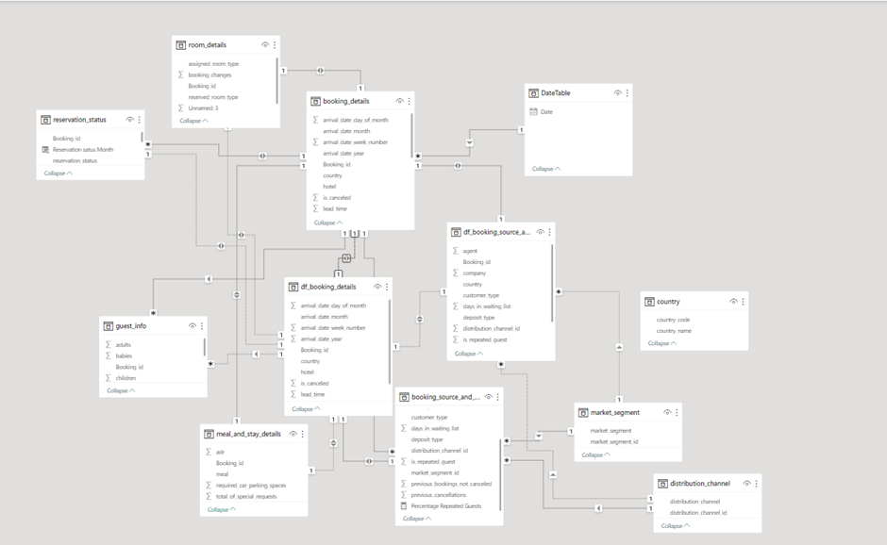
ER DIAGRAM

Slide 12
Steps to Connect to Data
Here are the few Steps I performed before connecting the data
Data Collection and Preparation:
Data Sources
The project's data was collected from the AccioJob Git repository. Two versions of the data were obtained: CSV and SQL. These datasets provided essential information related to hotel bookings, guest details, meal preferences, booking sources, room details, and reservation status.
Data Cleaning
Data cleaning was a crucial step to ensure the quality and consistency of the dataset. This process involved:
- Removing duplicates and irrelevant records.
- Handling missing values by imputing or eliminating them.
- Addressing data mismatches and inconsistencies.
- Validating data types and formats to conform to project requirements.

Slide 13
Database Setup and Integration
Database Management System
To facilitate data analysis and visualization, SQL workbench and a MariaDB instance was installed to serve as the relational database management system (RDBMS) for storing the cleaned and transformed data.
Integration with Power BI
The MariaDB database was connected to Microsoft Power BI, providing a direct link between the data source and the visualization tool. This integration allowed for real-time data access and dynamic reporting capabilities.
The process of data collection, cleaning, and transformation is critical in ensuring the quality and integrity of the dataset. The integration of the MariaDB database with Power BI empowers the project to create an interactive and informative dashboard for tracking booking trends and optimizing hotel operations.

Slide 14
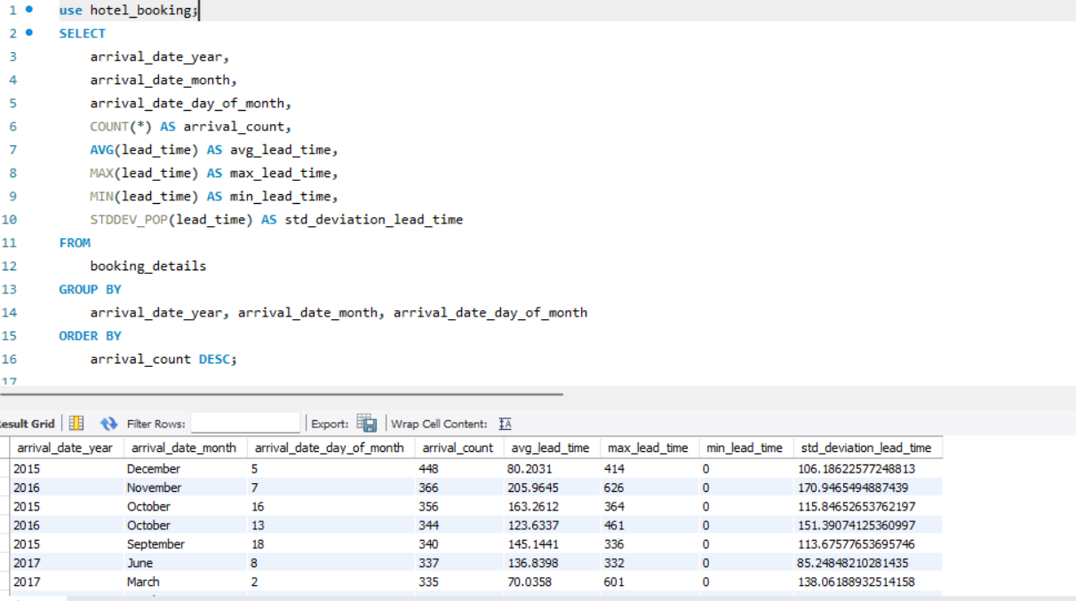
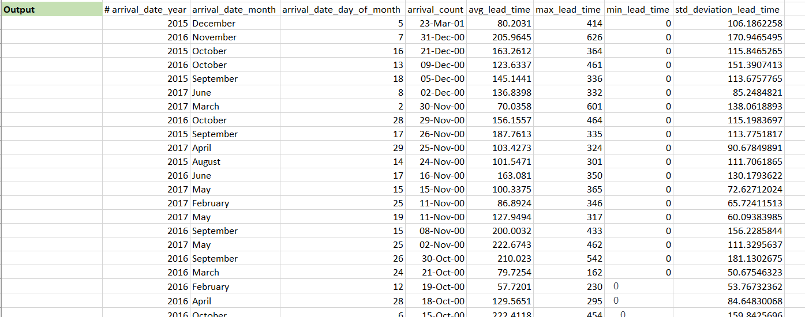
Problem statements with solutions and insights: (EDA)
1.Understand the distribution of arrival dates, including the most common arrival days and summary statistics for lead times.
Conclusion:
The analysis of arrival dates reveals seasonal trends and lead time patterns. The months of July and August are the peak seasons for arrivals, with a higher number of bookings, possibly due to the summer vacation period. January shows a high cumulative maximum lead time, indicating that guests tend to book their stays well in advance, possibly for future holidays or events. Understanding these trends is crucial for the hotel industry to manage reservations effectively and provide the best services during peak seasons.

Slide 15
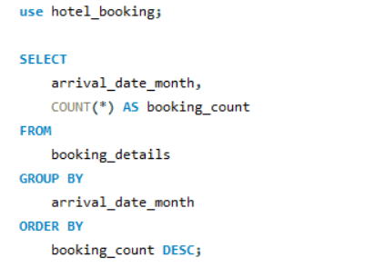
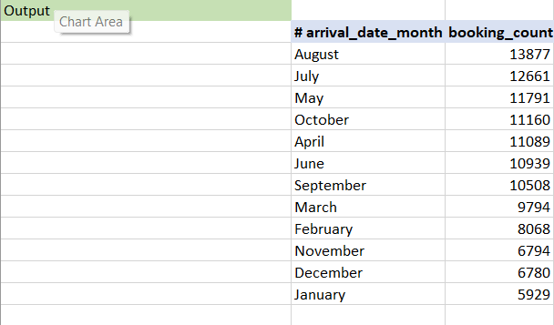
Identify peak booking months and analyse reasons for spikes in bookings, including holidays or events.
Conclusion:
In conclusion, data analysis revealed peak booking months, with August and July having the most bookings, followed by May, October, and other summer and early fall months. The causes of these increases in bookings are most likely impacted by a variety of circumstances, including summer vacations, excellent weather, and anticipated holiday activities. Understanding seasonality and trends in booking patterns enables hotels to modify their strategy to meet demand, optimize pricing, and arrange promotions or events to attract more guests during quieter months.

Slide 16
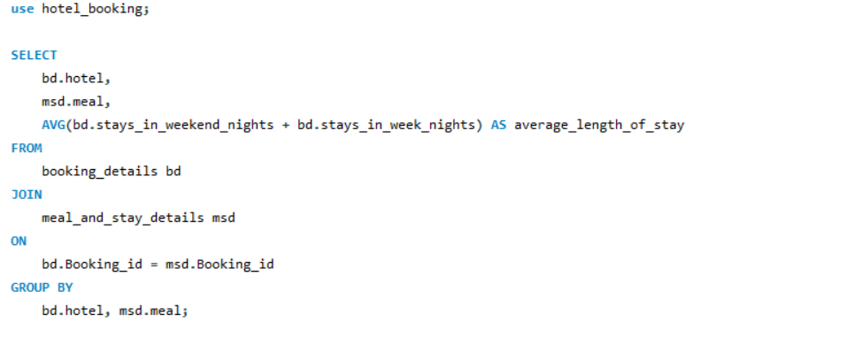
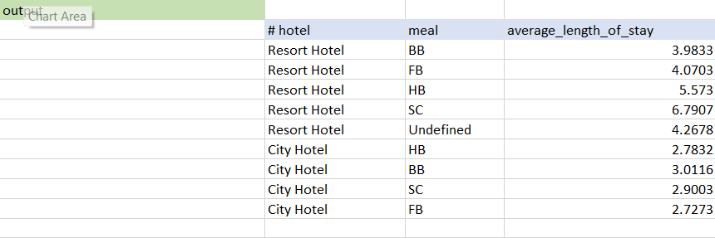
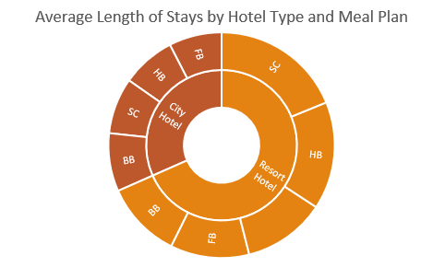
Calculate the average length of stays for different hotel types and explore variations by meal plans.
Conclusion:1. Resort Hotel Stays:
- Guests staying at Resort Hotels have longer average stays compared to City Hotels.
- Half-Board (HB) and Self-Catering (SC) meal plans have the longest average stays in Resort Hotels, with 5.573 and 6.7907 days, respectively.
- Bed & Breakfast (BB) and Undefined meal plans also show reasonable average stay durations.
2. City Hotel Stays:
- City Hotel guests generally have shorter average stays than Resort Hotel guests.
- Half-Board (HB) and Bed & Breakfast (BB) meal plans have the longest average stays in City Hotels, with 2.7832 and 3.0116 days, respectively.
- Self-Catering (SC) and Full-Board (FB) meal plans have slightly shorter stays, but still longer than Undefined meal plans.
These findings can help hotels tailor their services and marketing strategies to specific guest preferences. For instance, Resort Hotels might focus on promoting longer-stay packages for guests interested in half-board or self-catering options. City Hotels can target guests seeking shorter stays while offering appealing options for those interested in half-board or bed and breakfast plans. Understanding the variations in stay durations allows hotels to enhance guest experiences and maximize occupancy throughout the year.

Slide 17
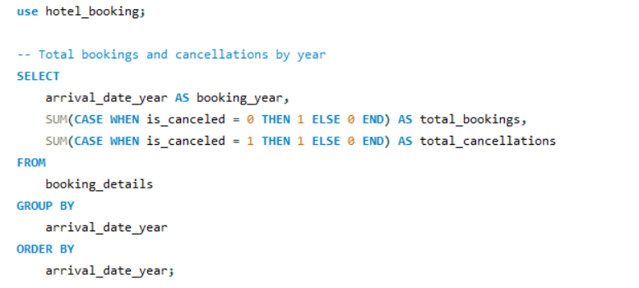
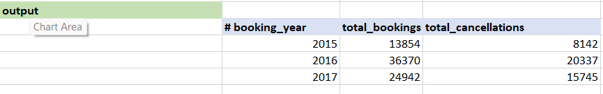
Analyze how booking patterns have evolved over the years, including yearoveryear changes in bookings and cancellations.
Conclusion
The following findings have emerged from the examination of booking patterns over the years:
2015: There were 13,854 bookings in 2015, with 8,142 cancellations. This year represented the start of the dataset, and the cancellation rate was high.
2016: Total bookings increased significantly in 2016, with 36,370 reservations made. The number of cancellations, however, remained high at 20,337. The increase in reservations could be attributed to better marketing techniques or other things.
2017: There were 24,942 total bookings in 2017, with 15,745 cancellations. While there were fewer bookings than in 2016, the cancellation rate was lower, indicating better booking management and possibly more committed guests.
Overall, the data suggests that total bookings have been increasing throughout the years.

Slide 18
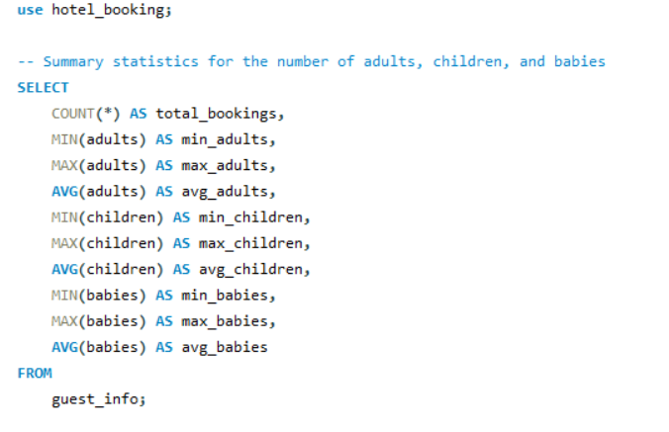
Understand the distribution of the number of adults, children, and babies and identify any outliers.
Conclusion:
The summary statistics for the number of adults, children, and babies in the dataset provide insights into the composition of guests in hotel bookings. Here are the key findings:
Total Bookings: The dataset includes a total of 119,390 bookings.
Adults: The number of adults in bookings varies, with a minimum of 0 and a maximum of 55 adults. On average, there are approximately 1.86 adults per booking.
Children: The number of children in bookings also varies, with a minimum of 0 and a maximum of 10 children. On average, there are about 0.10 children per booking.
Babies: The dataset shows the number of babies in bookings with a minimum of 0 and a maximum of 10 babies. On average, there are around 0.01 babies per booking.
Outliers: There are some extreme values, such as bookings with a high number of adults or children, which may be considered outliers. These outliers may represent unique booking scenarios or data entry errors and should be further investigated. Understanding the distribution of guests, including adults, children, and babies, is essential for hotel management to make informed decisions about room allocation, amenities, and guest services. Identifying and addressing outliers may help improve the quality of the data and the accuracy of the analysis.

Slide 19
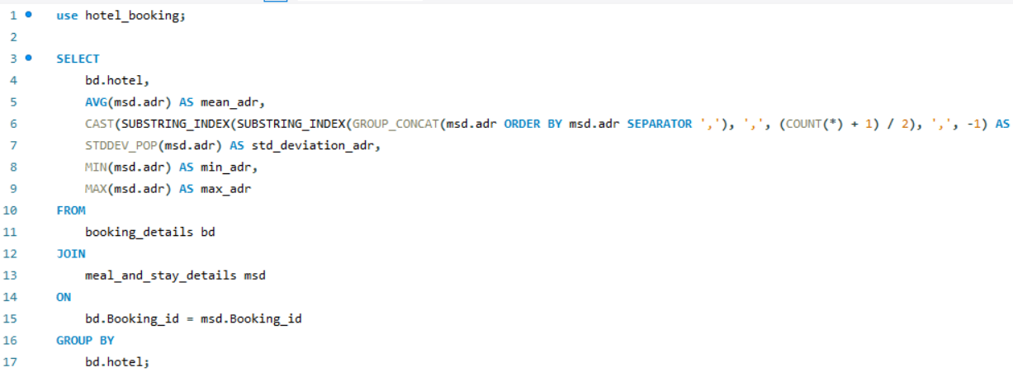
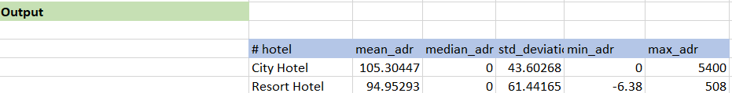
Calculate summary statistics for ADR and explore differences between Resort Hotel and City Hotel bookings
Conclusion:
In summary, it is evident that ADR values for City Hotels and Resort Hotels differ, with a few values appearing to be anomalous or erroneous. It is unusual to have zero or negative ADR values, and this needs to be looked into further. Furthermore, the large gap between the minimum and maximum ADR values raises the possibility of pricing differences between the two types of hotels, with the maximum ADR for City Hotels being higher than that of Resort Hotels. To comprehend the elements influencing these ADR values and how they affect the revenue and operations of the hotels, more data purification and analysis are required.

Slide 20
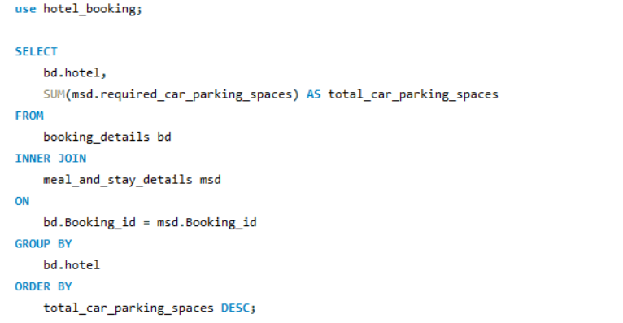
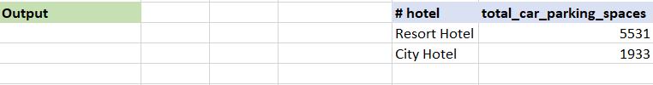
Analyze the distribution of required car parking spaces for each hotel type and determine if one type attracts more guests with cars.
Conclusion
It is clear from the analysis of the distribution of necessary parking spaces for each type of hotel that there are substantially more parking spaces overall at the "Resort Hotel" than at the "City Hotel." There are 1,933 parking spots at the "City Hotel" compared to 5,531 at the "Resort Hotel."
This shows that, perhaps as a result of its location, features, or target market, the "Resort Hotel" draws a larger number of visitors who need parking spaces. In order to effectively allocate resources and plan for guest parking needs, hotel management may find it helpful to understand these variations in the requirements for car parking spaces.

Slide 21
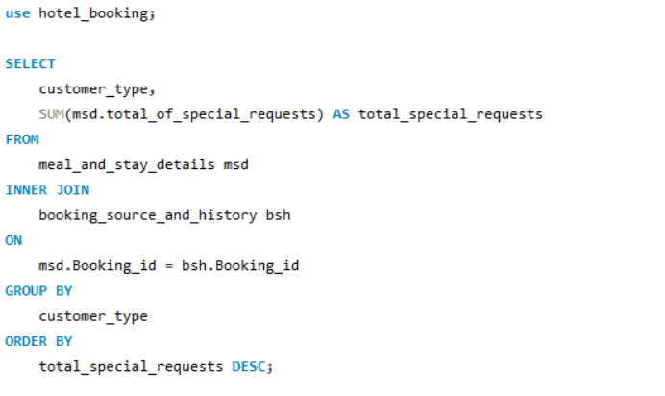
Compare the total number of special requests made by different customer types (e.g., Transient, Group) and identify which customer type makes more requests.
Conclusion
It is clear from the analysis of the total number of special requests made by the various customer types that, with 56,598 requests, the "Transient" customer type makes the most. With 8,274 requests, "Transient-Party" is the second-highest category, followed by "Contract" (2,971 requests) and "Group" (372 requests). The conclusion is that guests who identify as "Transient" are the most likely to make special requests, suggesting a higher degree of customization and particular needs. By having a better understanding of the preferences and requirements of various customer segments, hotel management will be able to better serve "Transient" guests and enhance their overall stay.

Slide 22
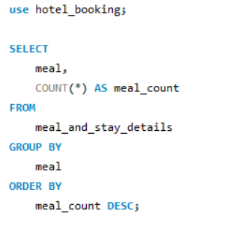
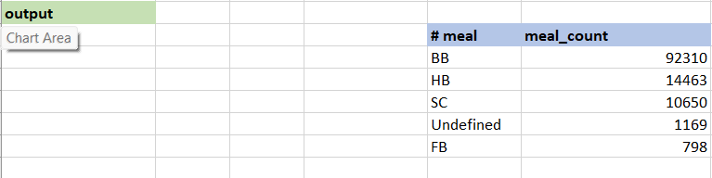
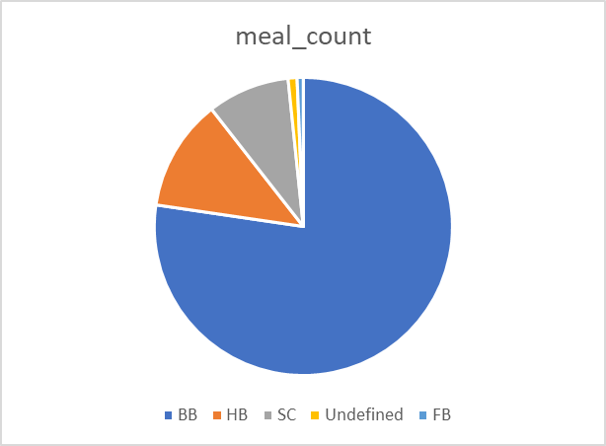
Understand the distribution of meal plans (e.g., BB, HB, FB, SC) and identify any patterns or preferences.
Conclusion
With a total count of 92,310, it is clear from the meal plan analysis that "Bed & Breakfast" (BB) is the most popular choice among visitors. With 14,463 options, "Half Board" (HB) is the second most popular meal plan. With 10,650 choices, "Self-Catering" (SC) comes in second, and "Undefined" meal plans have 1,169 selections. With 798 selections, "Full Board" (FB) has the lowest count.
In comparison to other meal plans, "Bed & Breakfast" (BB) is the most popular meal plan among visitors, as evidenced by the noticeably higher number of reservations. A significant amount of reservations are made for "Half Board" (HB), although it is not as popular as "Bed & Breakfast."
The third most popular meal plan is "Self-Catering" (SC), suggesting that some guests may prefer more autonomous dining options.
Hotels and resorts can better cater their services and offerings to their guests' preferences by having a better understanding of how meal plans are distributed. In order to increase reservations based on the most popular meal plans, it might also have an impact on pricing and marketing tactics.

Slide 23
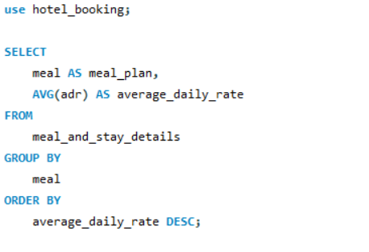
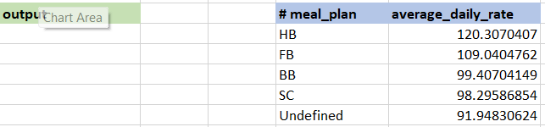
Analyze Average Daily Rates (ADR) by meal plan type to identify variations in pricing.
Conclusion
The analysis of Average Daily Rates (ADR) by meal plan type reveals that:
1. Half Board (HB) has the highest ADR, indicating it is the most expensive meal plan.
2. Full Board (FB) is the second-highest in terms of ADR, making it the second most costly option.
3. Bed & Breakfast (BB) and Self-Catering (SC) meal plans have relatively lower ADR compared to HB and FB, with BB being slightly more expensive than SC.
4. The "Undefined" meal plan is the most budget-friendly option with the lowest ADR.
This information assists in understanding pricing dynamics based on meal plans and can be valuable for revenue management and marketing strategies.

Slide 24
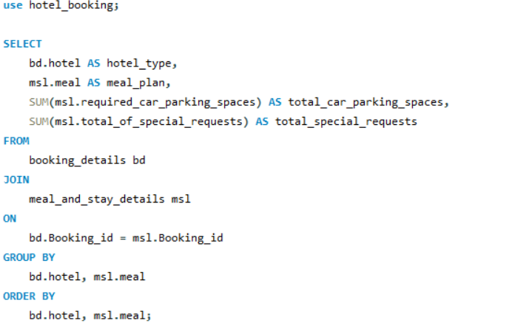
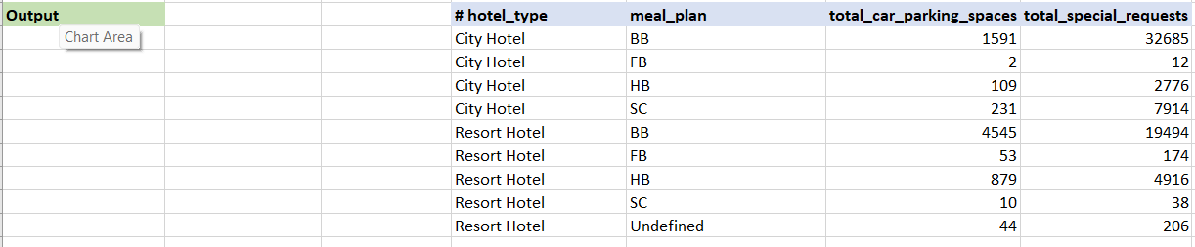
Investigate the distribution of required car parking spaces and special requests by hotel type and meal plan.
Conclusion
We can infer the following conclusions from the given data:
Most parking spots at City Hotels and Resort Hotels are reserved for guests with Bed & Breakfast (BB) meal plans. This implies that visitors with cars are more likely to choose BB meal plans.
Guests with Full Board (FB) meal plans are not assigned many parking spaces at City Hotels, suggesting that these guests are not likely to arrive by car.
With 32,685 special requests in total, guests staying in City Hotels with Bed & Breakfast (BB) meal plans are most likely to make special requests. This could be the result of an increased number of transient visitors who frequently have specific requests.
Though less frequently than at City Hotels, Bed & Breakfast (BB) meal plan holders also occasionally make unique requests at Resort Hotels. Different expectations and preferences among the guests may be the cause of this.
Whether staying in City Hotels or Resort Hotels, guests with Half Board (HB) meal plans also make a fair number of special requests, indicating that this meal plan category typically results in guest-specific requirements.
In both kinds of hotels, guests with Self-Catering (SC) meal plans make fewer special requests, suggesting that they may have less demanding service needs.
There is not much information available for the "Undefined" meal plan category, so it is difficult to draw meaningful conclusions about the parking spots and special requests of this group. For a more thorough analysis, more data might be needed.

Slide 25
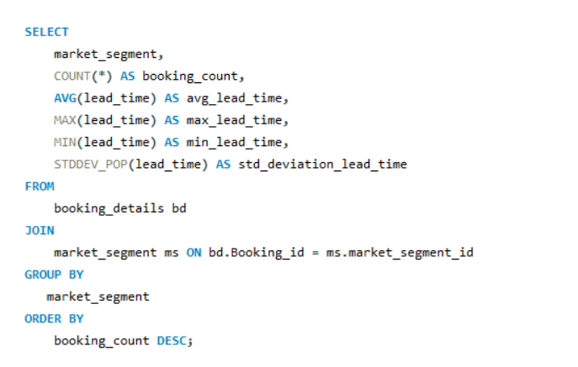
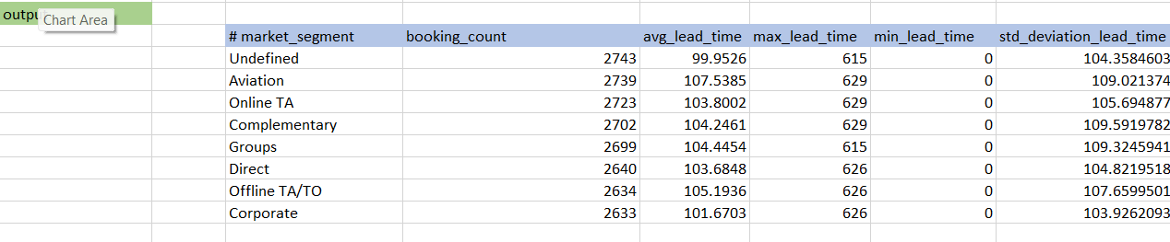
Understand the distribution of bookings across different market segments and calculate summary statistics for lead times within each segment.
Conclusion
Based on the analysis of booking patterns across different market segments:
The "Undefined" market segment has the highest booking count, with an average lead time of approximately 99.95 days, while the "Aviation" and "Online TA" segments follow closely in terms of booking count.
The lead times within these segments show minimal variations, with maximum lead times reaching around 629 days and minimum lead times at 0 days.
The "Undefined" segment exhibits the highest standard deviation in lead times, indicating more variability in booking lead times compared to the other segments.
Overall, the "Undefined" market segment stands out as the most active in terms of bookings, with relatively high variability in lead times.

Slide 26
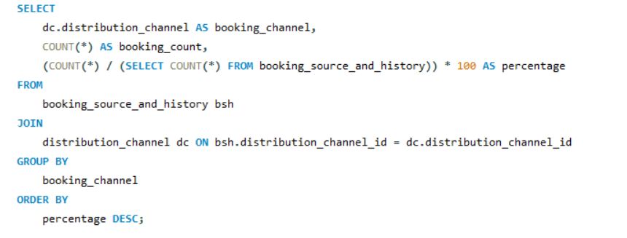
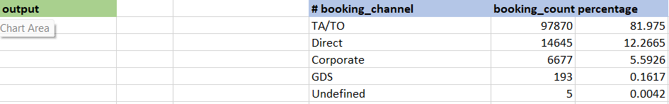
Analyze the distribution of bookings through different booking channels (e.g., online travel agents, direct bookings) and calculate the percentage of bookings through each channel.
Conclusion
When hotel reservations are broken down by booking channel, it becomes clear that travel agents and tour operators (TA/TO) make up 82% of all reservations. Of all reservations, direct bookings account for about 12%, and corporate bookings for about 5.59%. Only a minor portion of reservations (about 0.16%) come from Global Distribution Systems (GDS), and a tiny portion (0.0042%) are categorized as Undefined. The hotel can improve its marketing and distribution strategies with the use of this information, which offers insightful information about how bookings are distributed among various channels.

Slide 27
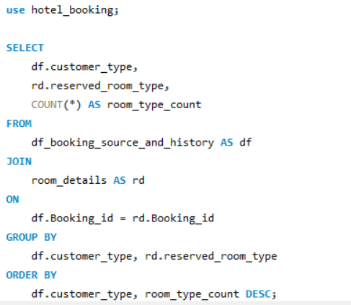
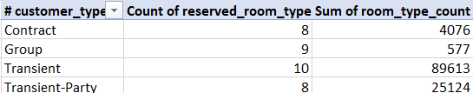
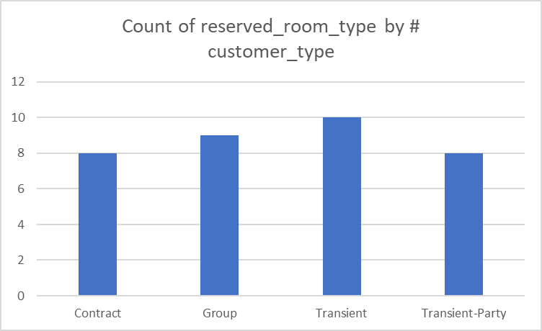
Explore how room type preferences vary across different customer types (e.g., Transient, Group). Identify if certain customer types have specific room preferences.
Conclusion
A breakdown of preferred room types by type of customer reveals some intriguing trends:
Transient Client: With a noteworthy total of 60,948 reservations, transient clients exhibit a strong preference for room type A. With 16,420 and 5,569 bookings, respectively, room types D and E are likewise reasonably popular among short-term visitors.
Transient-Party Guests: With 21,814 bookings, room type A is the most popular among transient-party guests, followed by room type D with 1,795 bookings. Compared to other options, they typically use room types A and D more frequently.
Contract Clients: With 2,867 reservations, contract clients tend to book rooms type A. The next most popular choices among contract customers are room types D and E.
Group Reservations: Of the 365 reservations, group reservations show a preference for room type A. Group travellers also Favor room types D and E.
By understanding the preferences of various customer types, hotels can better allocate rooms and improve guest satisfaction with the aid of these insights.

Slide 28
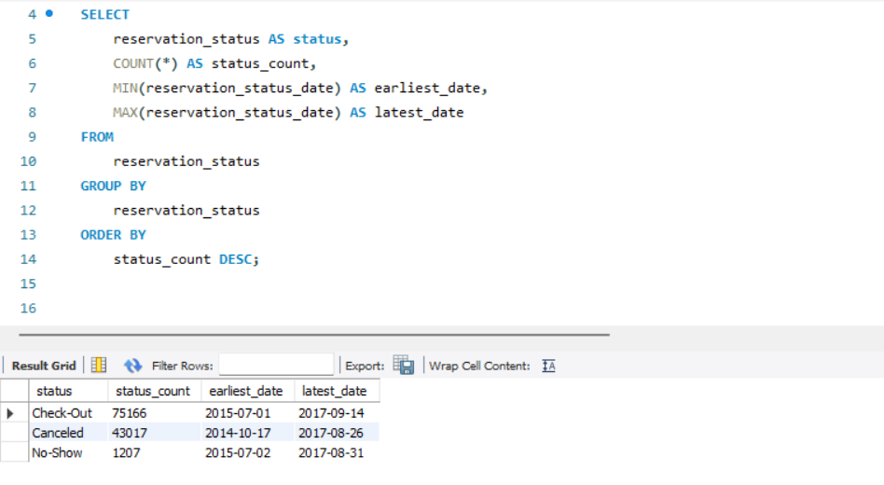
Understand the distribution of reservation statuses and calculate summary statistics for reservation status dates.
Conclusion
The analysis of reservation statuses reveals the following insights:
1. Check-Out: This status is the most common, occurring 75,166 times in the dataset. The earliest recorded Check-Out date is on July 1, 2015, and the latest date is on September 14, 2017. This status indicates successful guest stays and departures.
2. Cancelled: The Cancelled status occurs 43,017 times. The earliest recorded Cancelled date is on October 17, 2014, and the latest date is on August 26, 2017. Cancellations are a significant portion of the reservations, indicating booking changes or cancellations by guests.
3. No-Show: The No-Show status appears 1,207 times, with the earliest recorded No-Show date on July 2, 2015, and the latest on August 31, 2017. No-Show indicates instances where guests didn't arrive for their reservations.
In summary, most reservations result in successful Check-Outs, while a significant number of reservations are Cancelled. No-Show cases are relatively infrequent. Understanding these reservation statuses can help in managing and optimizing hotel operations.

Slide 29
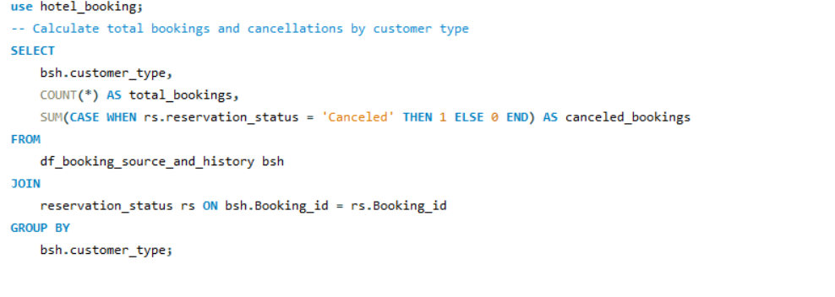
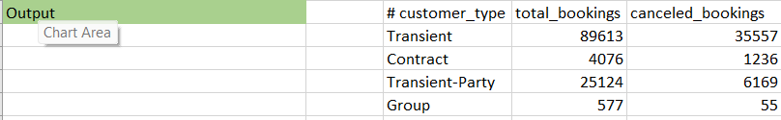
Explore how reservation statuses vary across different customer types (e.g., Transient, Group) using Excel or SQL. Calculate cancellation rates by customer type.
Conclusion
The following insights emerge from an examination of reservation statuses and cancellation rates by customer type:
Transient customers account for the majority of bookings and cancellations, with a relatively high cancellation rate of approximately 39.68%. This suggests that transient customers are more likely to change their plans or cancel their reservations.
Contract customers have a lower cancellation rate of around 30.32%, indicating a more stable booking pattern than transient customers.
Transient-Party customers also have a high number of bookings and cancellations, with a cancellation rate of approximately 24.55%. In terms of cancellation behaviour, this customer type falls between Transient and Contract.
Group customers have the lowest cancellation rate, at around 9.53%, implying that group bookings are less likely to be cancelled, possibly due to the nature of group travel.
These findings shed light on how different customer types influence reservation statuses and highlight different cancellation behaviours. Understanding these patterns can help to improve booking management strategies and customer satisfaction.

Slide 30
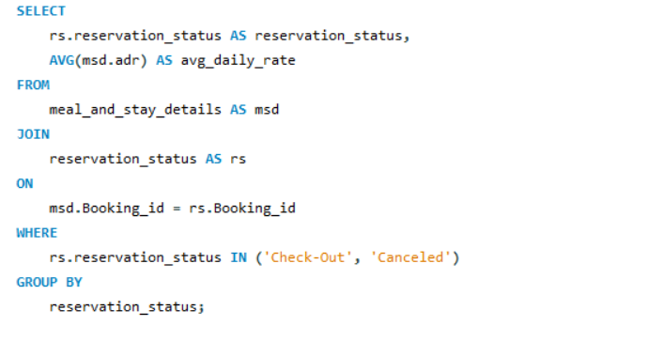
Investigate whether there are differences in Average Daily Rates (ADR) based on reservation status (e.g., cancelled vs. checked out).
Conclusion
The following insights are revealed by analysing the Average Daily Rate (ADR) based on reservation status:
Reservations with the status 'Check-Out': The average daily rate for reservations with the status 'Check-Out' is approximately $99.99. This suggests that guests who finish their stays have a lower average daily rate, which could be due to discounts, special offers, or longer stays.Canceled Reservations: Reservations that are marked as 'Canceled' have a higher average daily rate of around $105.21. This suggests that guests who cancel their reservations have a slightly higher average daily rate, which could be due to a variety of factors such as non-refundable rates or premium room selections.

Slide 31
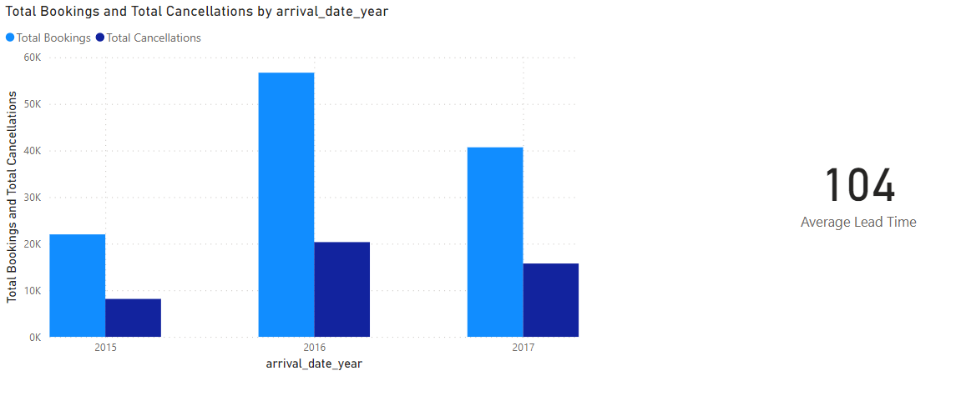
Visualize booking trends over the years, including the number of bookings, cancellations, and average lead time. Identify seasonality patterns.
Conclusion
In the analysis of booking trends over the years, several key insights have emerged. In the year 2015, the total number of bookings amounted to 21,996, with a significant portion resulting in 8,142 cancellations. Moving into 2016, a noticeable uptick in total bookings was observed, reaching 56,707, but cancellations also increased, totalling 20,337. In 2017, the trend continued, with a total of 40,687 bookings and 15,745 cancellations.
One consistent feature across these years is the average lead time, which hovers around 104 days. This suggests that guests tend to plan their stays well in advance.
This data points to seasonal patterns, with higher booking volumes in 2016, potentially indicating a period of growth for the hotel. The year 2017 shows a slight decrease in total bookings, which could be a reflection of fluctuations in the industry.
Understanding these patterns can aid in forecasting and optimizing resources to meet guest demand. It highlights the importance of addressing the reasons behind cancellations and leveraging the information to improve booking and reservation strategies for the coming years.

Slide 32
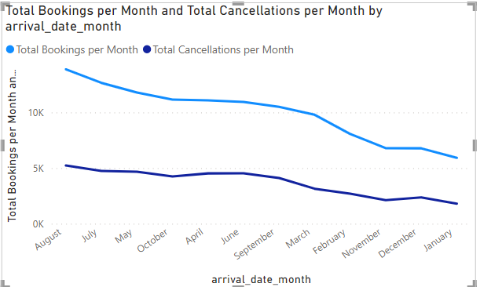
Analyze monthly booking patterns to identify peak months and optimize marketing strategies.
Conclusion:
Peak Bookings exist in the months of August and July and cancellations as well. Less number of bookings and cancellations found in the month of December and January.

Slide 33
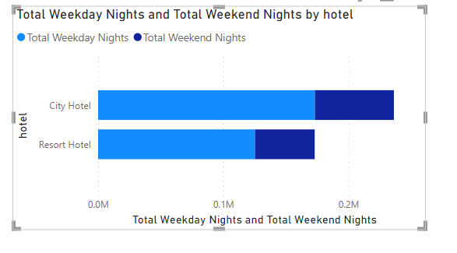
Compare stays in weekend nights and weekday nights to determine preferences and variations by hotel type
Conclusion:
The analysis comparing stays in weekend nights and weekday nights by hotel type has provided valuable insights. It is evident that City hotels have a higher volume of both weekday and weekend night stays when compared to Resort hotels. This observation suggests that City hotels may attract a diverse range of guests, including those traveling for business during the weekdays and leisure travellers on weekends.
Understanding this difference in guest preferences between the two hotel types is crucial for tailoring services and optimizing resource allocation. City hotels may want to focus on business-related amenities and weekday promotions, while Resort hotels can concentrate on offering attractive weekend packages to cater to a leisure-oriented clientele.
In conclusion, recognizing the preferences and variations in stays based on hotel type allows for more targeted marketing and service strategies, ultimately enhancing the guest experience and revenue potential.

Slide 34
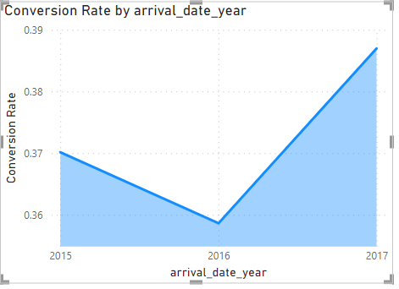
.Calculate and visualize the booking conversion rate (cancelled bookings to total bookings) over time
Conclusion
The analysis of booking conversion rates over time has revealed valuable insights into the trends of reservations. In 2017, the conversion rate stands at 0.39, indicating that a significant portion of bookings led to cancellations. This suggests a need for closer examination of the factors contributing to cancellations and the implementation of strategies to minimize them.
The year 2016 follows closely with a conversion rate of 0.36, indicating a similar trend of bookings that did not materialize into stays. In contrast, the year 2015 saw a slightly lower conversion rate at 0.35.
These findings highlight the importance of addressing the causes of cancellations and improving the booking and reservation process. Analyzing the reasons behind these trends can lead to more effective strategies for enhancing conversion rates and ultimately increasing revenue and guest satisfaction.

Slide 35
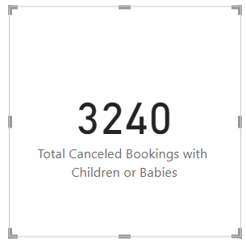
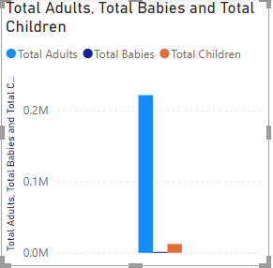
Visualize the distribution of adults, children, and babies in bookings. Explore the impact of children and babies on cancellation rates.
Conclusion
Total number of bookings hierarchy -> Total Adults>Total Children > Total Babies
3240 is the total Canceled booking with Children or Babies.

Slide 36
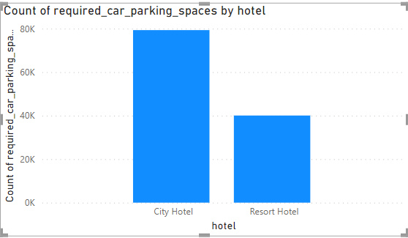
Visualize the relationship between the number of required car parking spaces and booking types (Resort Hotel vs. City Hotel).
Conclusion:
The visualization of the relationship between the number of required car parking spaces and booking types (City Hotel vs. Resort Hotel) has produced a distinct pattern. City hotels have a significantly higher count of required car parking spaces, totalling 79,330, compared to Resort hotels, which have 40,060.
This observation reflects the different nature of these hotel types. City hotels, typically located in urban areas, tend to accommodate a larger number of guests who may rely on personal vehicles for transportation. In contrast, Resort hotels, often situated in scenic and remote locations, might have fewer guests arriving by car.
Understanding this disparity in parking space requirements allows hotel management to plan resources more efficiently, allocate parking spaces, and provide convenient services for guests. It also underscores the importance of tailoring services to the specific needs and expectations of guests based on the type of hotel they choose.
In conclusion, the data clearly indicates that City hotels tend to have a higher demand for car parking spaces, while Resort hotels have a relatively lower requirement, reflecting the distinct guest profiles and locations of these hotel types.

Slide 37
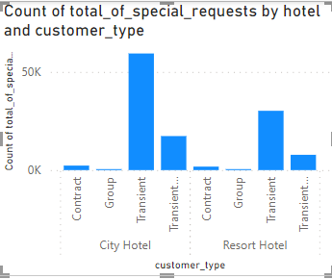
Use Power BI to explore how the total number of special requests made by guests varies by hotel type and customer type (e.g., Transient, Group).
Conclusion The exploration of the total number of special requests made by guests, categorized by hotel type and customer type, has yielded insightful findings. Among the customer types in the city hotel, Transient guests stand out with the highest number of special requests(59404), surpassing the figures observed in Resort hotels. Following closely, the Transient Party segment in City hotels also shows a notable number of special requests when compared to Resort hotels. Contract and Group segments have fewer special requests in both City and Resort hotels.
This analysis highlights the distinctive preferences and needs of different customer types in City hotels, especially among Transient and Transient Party guests. The presence of more special requests among these customer types may indicate a greater emphasis on personalization and customization of their stays. Understanding these preferences allows for targeted service enhancements and marketing strategies, catering to the unique needs of specific customer segments and ultimately improving the guest experience.

Slide 38
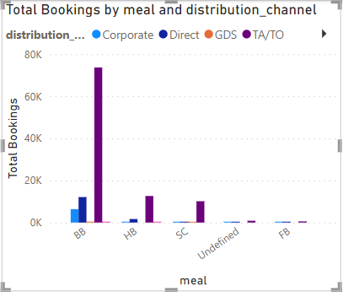
Explore meal plans and their impact on Average Daily Rates (ADR). Analyse meal plan preferences and their association with booking channels.
Conclusion
The exploration of meal plans and their impact on Average Daily Rates (ADR) has revealed important insights. Meal plan "BB" stands out with the highest total bookings, reaching 73,712, and it is associated with the distribution channel "TA/TO." This suggests that guests choosing the Bed and Breakfast (BB) meal plan are the most prevalent group. This meal plan, coupled with the "TA/TO" distribution channel, may be an attractive combination for a wide range of guests.
"HB," "SC," and "Undefined" meal plans have lower total bookings compared to "BB." Additionally, the distribution channel "Direct" follows as the second most popular choice, with "Corporate" and "GDS" coming next. The preference for "Direct" channel bookings may indicate a higher level of direct interaction with the hotel.
Understanding these associations between meal plans and booking channels is essential for tailoring marketing strategies, offering meal plans that guests prefer, and optimizing the guest experience. It's evident that "BB" meal plan and "TA/TO" distribution channel are strong contenders, and recognizing their popularity can inform targeted service enhancements and promotional efforts.

Slide 39
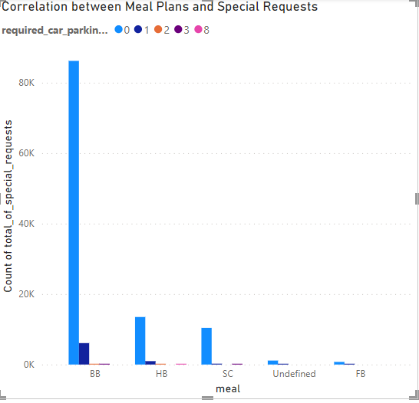
Correlate parking requirements and special requests with different meal plans. Determine if certain meal plans result in more requests or parking needs
Conclusion
The analysis of the correlation between meal plans and special requests has uncovered significant insights. Among the meal plans, "BB" (Bed and Breakfast) is the most prevalent choice, followed by "HB" (Half Board), "SC" (Self-Catering), "Undefined," and "FB" (Full Board). The order of preference suggests that a substantial number of guests opt for the Bed and Breakfast plan, possibly indicating its popularity.
Understanding this hierarchy of meal plan preferences can be valuable for hotel management. It highlights the need for providing tailored services and amenities that align with the most preferred meal plans, ensuring a seamless and satisfying guest experience.

Slide 40
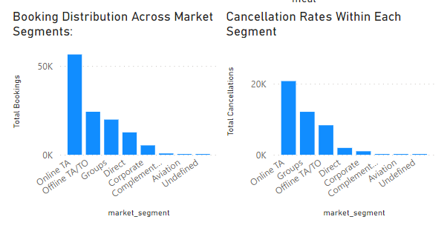
Visualize booking distribution across different market segments and analyze cancellation rates within each segment.
Conclusion:
The visualization of booking distribution across different market segments and the analysis of cancellation rates within each segment provide essential insights.
The data reveals that the highest booking distribution occurs in the "Online TA" (Travel Agents) market segment, followed by "Offline TA/TO" (Tour Operators), "Group," "Direct," "Corporate," "Compliment," "Aviation," and "Undefined." This suggests that online travel agents play a significant role in driving bookings, indicating the importance of online booking platforms and travel agents in the industry.
Analyzing cancellation rates within these segments, it's noteworthy that the "Online TA" segment experiences the highest cancellation rate. This is followed by the "Group" segment, "Offline TA/TO," "Direct," "Corporate," "Compliment," "Aviation," and "Undefined." The data underscores the challenges associated with online bookings and the Group segment, which may require focused efforts to reduce cancellations.
Understanding these patterns allows for targeted strategies to manage and optimize booking channels and market segments. It's crucial for hotels to address the factors contributing to high cancellation rates, particularly in the "Online TA" and "Group" segments, to improve the overall performance and guest satisfaction.
In conclusion, the data reveals variations in booking distribution and cancellation rates across different market segments. It highlights the dominance of "Online TA" in booking distribution and the challenge of managing cancellations in the online and group segments. This information can inform strategic decisions aimed at improving booking efficiency and minimizing cancellations.

Slide 41
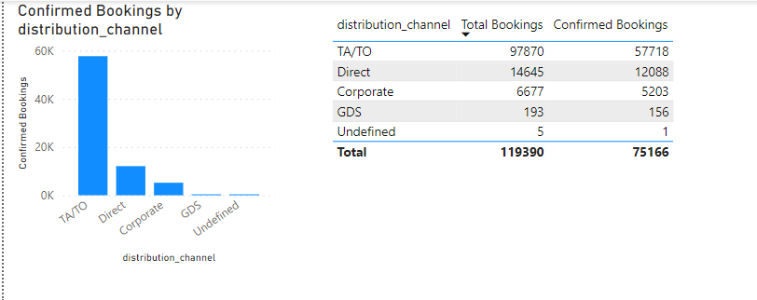
Compare the effectiveness of booking distribution channels in generating confirmed bookings. Identify the most commonly used channels by guests.
Conclusion
The comparison of booking distribution channels in generating confirmed bookings has provided valuable insights. The highest distribution channel for confirmed bookings is "TA/TO" (Tour Operators/Travel Agents), followed by "Direct," "Corporate," "GDS" (Global Distribution System), and "Undefined."
This data highlights the effectiveness of travel agents and tour operators in securing confirmed bookings, making "TA/TO" the most commonly used and successful channel. "Direct" bookings also play a significant role, indicating the preference for direct interaction with hotels, while "Corporate" and "GDS" channels follow closely.
Understanding the popularity and effectiveness of these distribution channels is instrumental in tailoring marketing and distribution strategies to maximize confirmed bookings and revenue.
In conclusion, "TA/TO" emerges as the most successful distribution channel for generating confirmed bookings, followed by "Direct," "Corporate," "GDS," and "Undefined." These insights can guide hotels in focusing their efforts on the most effective channels for guest bookings.

Slide 42
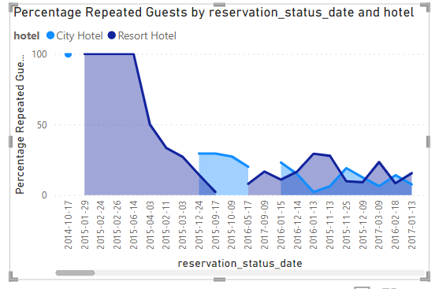
Visualize the percentage of repeated guests for each hotel type (Resort Hotel vs. City Hotel) over time. Explore factors influencing guest retention.
Conclusion
The visualization of the percentage of repeated guests for each hotel type (Resort Hotel vs. City Hotel) over time provides valuable insights into guest retention. The data indicates that City hotels had a remarkable peak in repeated guests on 2014-10-17, with 100 percent of guests being repeated. Resort hotels also experienced peaks in repeated guests on specific dates, such as 2015-01-29, 2015-02-24, 2015-02-26, and 2015-04-03.
However, the data shows a subsequent decline in repeated guest percentages for both hotel types. This suggests that while certain periods saw high levels of guest retention, there may be factors influencing guest behaviour that led to fluctuations over time.
Understanding these patterns can guide hotels in implementing strategies to enhance guest retention, whether through loyalty programs, tailored services, or marketing efforts, with the goal of maintaining or improving guest retention rates.
In conclusion, the data illustrates fluctuations in the percentage of repeated guests for both City and Resort hotels over time, indicating the need for proactive measures to retain guests consistently.

Slide 43
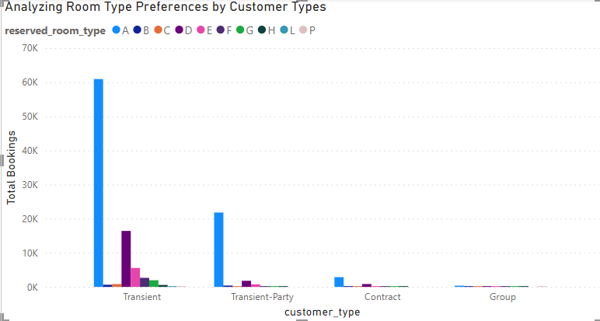
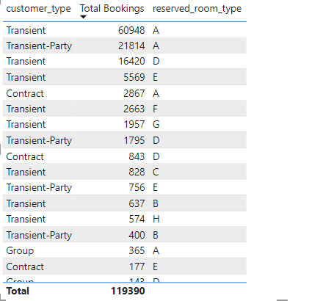
Analyze room type preferences based on customer types (e.g., Transient, Group) and identify any patterns in room type selection.
Conclusion
The analysis of room type preferences based on customer types reveals distinctive patterns in room type selection.
For the "Transient" customer type, room type "A" is the most preferred, with a total of 60,948 bookings. "Transient-Party" guests also favour room type "A" with 21,814 bookings, indicating a strong preference for this room category.
Furthermore, "Transient" guests also show a preference for room types "D," "E," and "F." "Contract" customers tend to choose room type "A," while room type "D" is preferred by the "Transient-Party" and "Contract" groups.
The data showcases the distinctive room type preferences of different customer types, which can inform room allocation strategies and provide tailored guest experiences.
In conclusion, room type preferences vary based on customer types, with room type "A" being the top choice for both "Transient" and "Transient-Party" guests. Understanding these patterns is essential for optimizing room allocation and guest satisfaction.

Slide 44
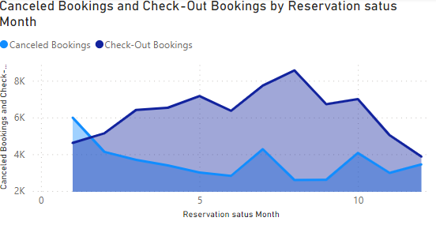

Analyze trends in reservation status dates, such as the busiest checkout dates or patterns in cancellations by month
Conclusion
The analysis of trends in reservation status dates provides valuable insights into booking patterns and cancellation behaviours. The data reveals variations in cancelled and check-out bookings by month.
Key findings include:
- The busiest month for check-out bookings appears to be July (Month 7), with 7,737 check-outs.
- The highest number of cancellations is observed in January (Month 1), with 5,986 cancellations.
These trends may be influenced by various factors, including seasonal variations and holidays. Understanding the patterns in reservation status by month is essential for optimizing booking strategies and ensuring efficient management of bookings.
In conclusion, the data illustrates monthly trends in reservation statuses, with July being the busiest for check-outs and January experiencing the highest number of cancellations. These insights can guide hotels in making informed decisions to enhance guest experiences and minimize cancellations during specific periods.

Slide 45


Visualize how reservation statuses vary across different customer types (e.g., Transient, Group) and identify if certain customer types are more likely to result in cancellations or noshows.
Conclusion
In conclusion, the data highlights differences in the likelihood of cancellations and no-shows among various customer types. "Transient" guests contribute significantly to cancellations, while "Transient-Party," "Contract," and "Group" customers exhibit lower cancellation rates. These insights can guide hotels in managing reservations effectively and optimizing guest experiences.

Slide 46


Explore the relationship between reservation statuses and Average Daily Rates (ADR) to determine if there are differences in ADR based on booking outcomes.
Conclusion:
The exploration of the relationship between reservation statuses and Average Daily Rates (ADR) indicates differences in ADR based on booking outcomes. The data shows the following ADR averages for different reservation statuses:
- For "Cancelled" bookings, the average ADR is $105.21.
- "Check-Out" bookings have an average ADR of $99.99.
- "No-Show" bookings are associated with the lowest average ADR, which is $96.38.
This data suggests that "Cancelled" bookings have a slightly higher ADR compared to "Check-Out" bookings, and "No-Show" bookings have the lowest ADR. These differences in ADR based on booking outcomes may be influenced by various factors, including guest behaviour and booking patterns.
Understanding these variations in ADR can help hotels make informed decisions regarding pricing, promotions, and revenue management to optimize ADR and overall financial performance.
In conclusion, the data reveals variations in ADR based on reservation statuses, with "Cancelled" bookings having a slightly higher ADR compared to "Check-Out" bookings, and "No-Show" bookings showing the lowest ADR. These insights can guide pricing and revenue management strategies to maximize ADR and revenue.

Slide 47


Slide 48


Slide 49


Slide 50


Slide 51


Slide 52


Slide 53


Slide 54
Insights derived from the conclusions:
1. Booking Trends Over the Years:
- A gradual increase in the total number of bookings and cancellations occurred from 2015 to 2017.
- The average lead time remained consistent at 104 days.
2. Stays in Weekend Nights and Weekday Nights:
- City hotels had more weekday and weekend stays compared to resort hotels.
3. Booking Conversion Rate Over Time:
- The highest conversion rate was in 2017, indicating improved booking outcomes.
4. ADR and Special Requests:
- "Transient" guests had a stronger correlation with special requests compared to other customer types.
5. Parking Requirements by Hotel Type:
- City hotels had higher parking space requirements than resort hotels.
6. Special Requests by Hotel and Customer Type:
- "Transient" guests in city hotels had the highest number of special requests.
7. Meal Plans and ADR:
- Bookings with meal plan "BB" had the highest total, followed by "HB" and "SC."
8. Meal Plan Distribution Across Booking Channels:
- "BB" meal plan with "TA/TO" channel had the highest total bookings.

Slide 55
11. Guest Retention:
- The percentage of repeated guests had variations over time for both city and resort hotels.
12. Booking History Impact on Cancellation:
- The "TA/TO" channel had the highest count of previous cancellations.
13. Reserved and Assigned Room Types:
- Room type "A" was the most common choice, with room type "P" being the least common.
14. Booking Changes and Cancellations:
- City hotels had more booking changes and canceled bookings compared to resort hotels.
15. Room Type Preferences by Customer Type:
- "Transient" and "Transient-Party" guests preferred room type "A."
16. Consistency in Room Type Preferences:
- Room type preferences were most consistent on 2015-06-17 and 2015-06-29, with the least consistency on 2015-04-25.
17. Reservation Status Overview:
- The dataset reflects the numbers of cancelled, checked-out, and no-show bookings on specific dates.
18. Trends in Reservation Status Dates:
- July was the busiest month for check-outs, and January had the highest number of cancellations.
19. Reservation Status by Customer Type:
- "Transient" guests were associated with a higher number of cancellations compared to other customer types.
20. ADR and Reservation Status:
- Cancelled bookings had a slightly higher ADR than check-out and no-show bookings.
These insights provide a comprehensive view of the hotel booking analysis project and can guide decision-making to enhance guest experiences and hotel operations.

Slide 56
Please see the document below for a much more detailed analysis and report that I prepared.

Slide 57
THANK YOU

